Slide 1


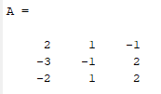

Labwork 3 – V: Gauss Elimination

Slide 2

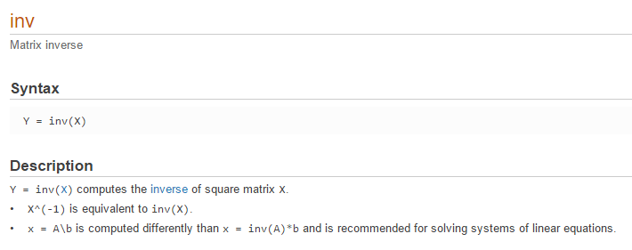

Slide 3
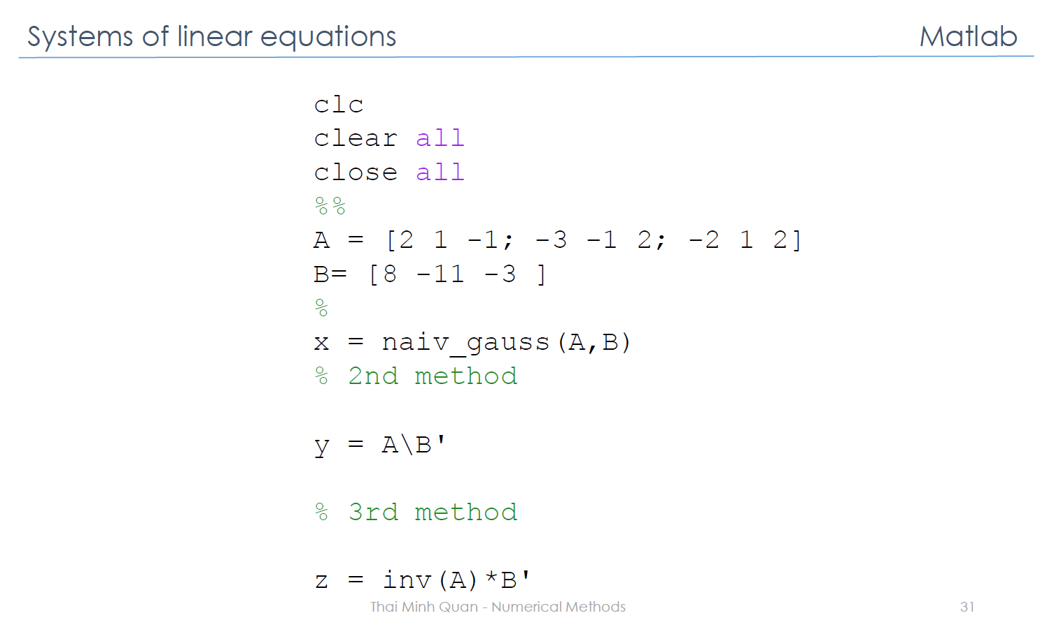

Slide 4


Slide 5

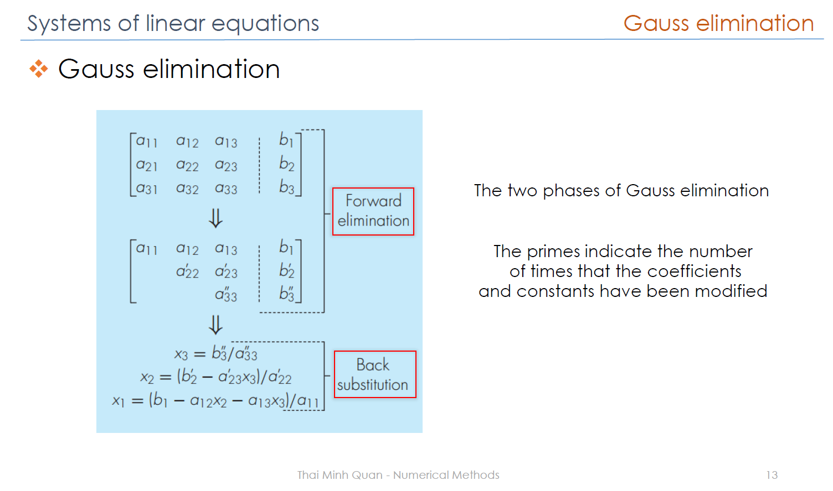
0*x1
0*x1
0*x2

Slide 6




Equation (1)
Equation (2)
Equation (n)
Equation (1)
Equation (1’)

Slide 7

Equation (2)
Equation (1’)
If we take Equation (2) – Equation (1’), then we get
We removed x1 from Equation (2) => we have Equation (2’)

Slide 8
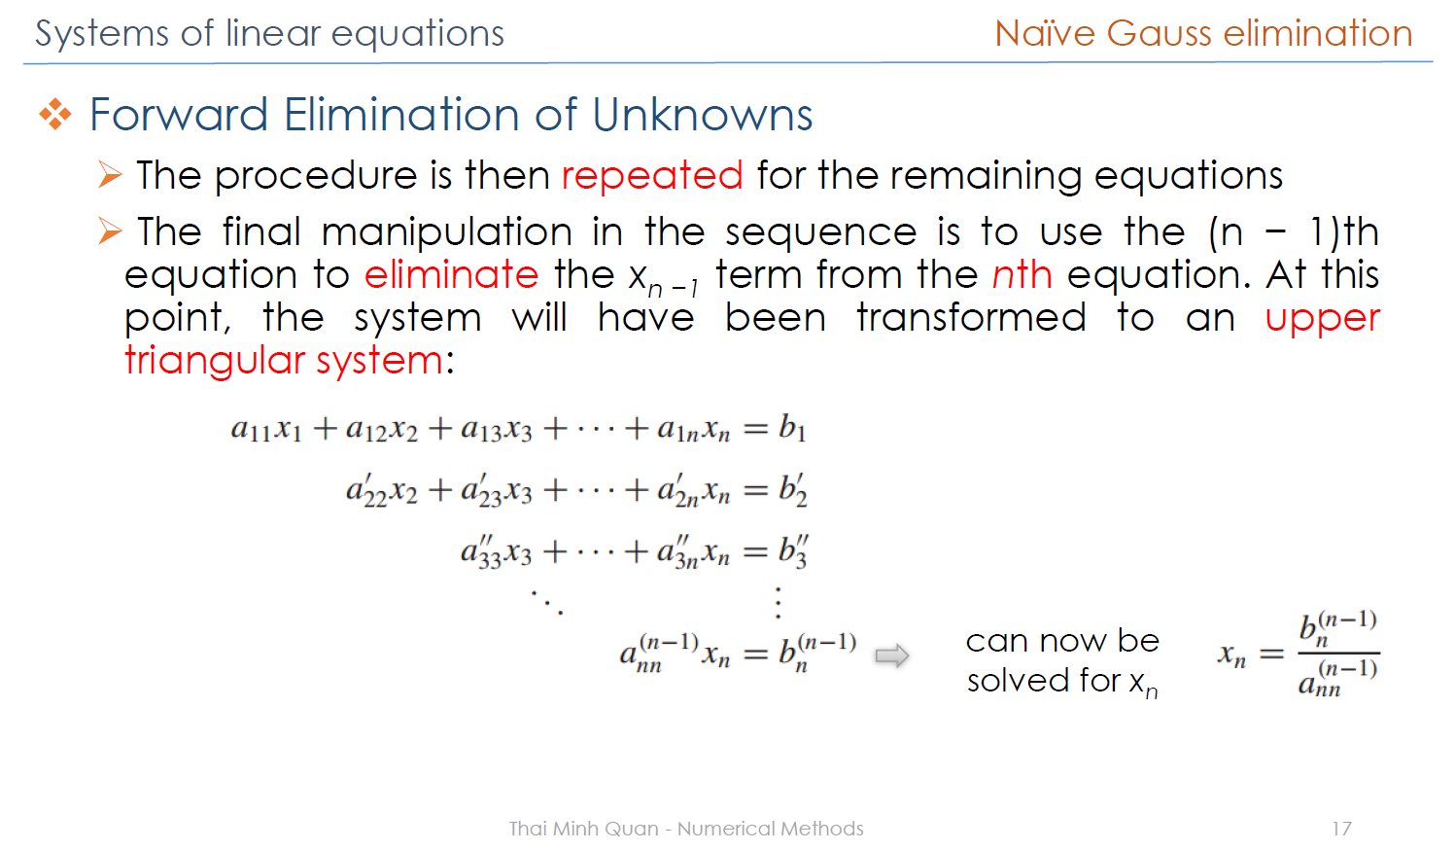

Slide 9
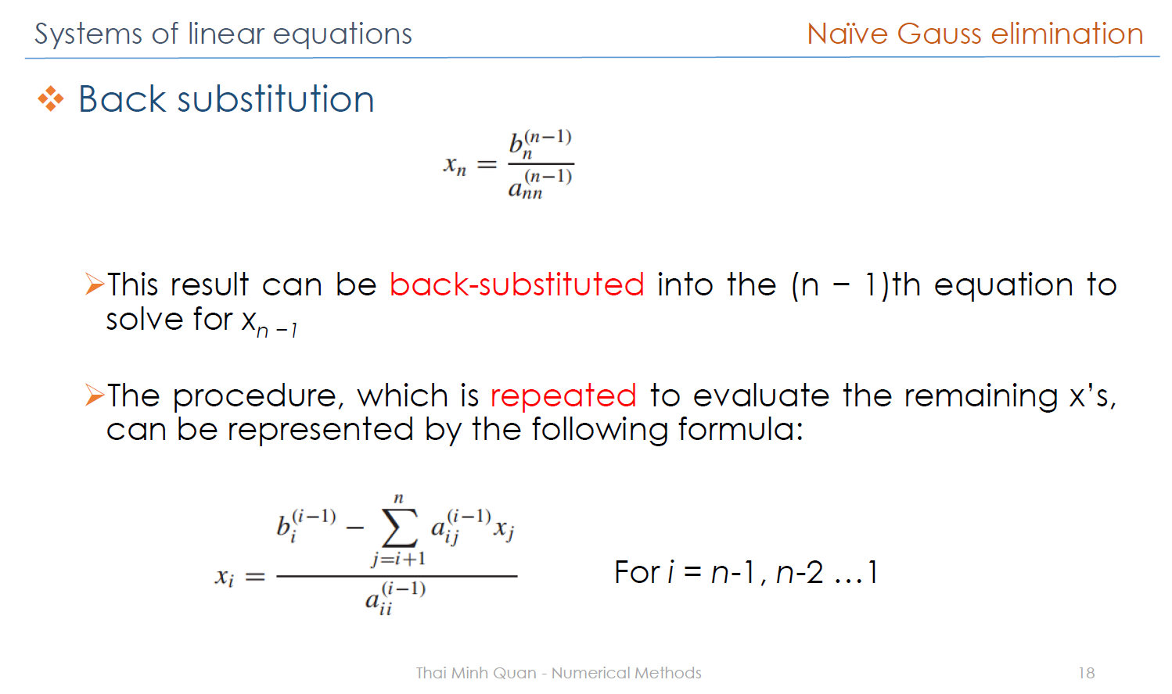

Slide 10
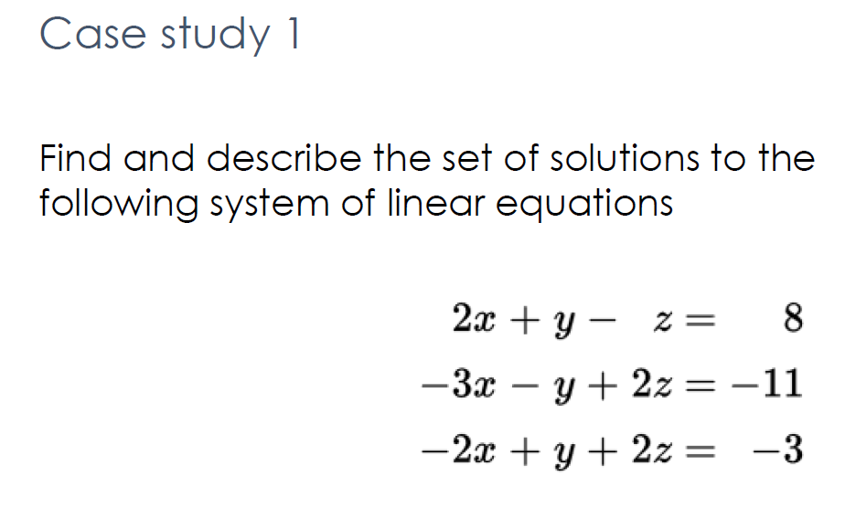
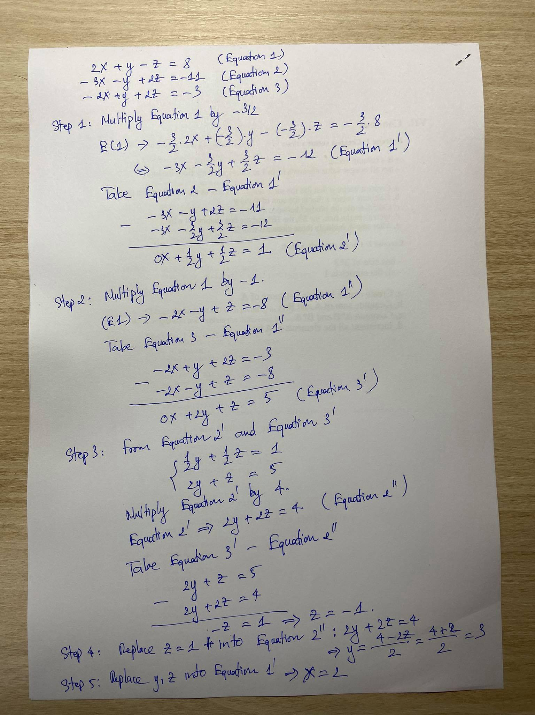
NO PIVOTING

Slide 11
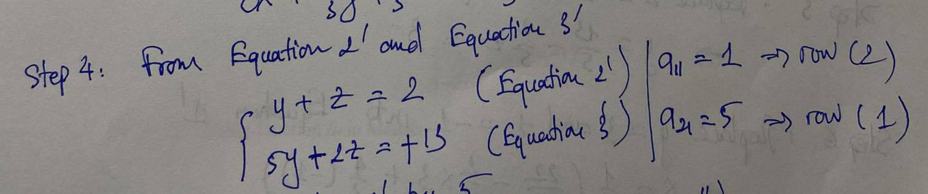
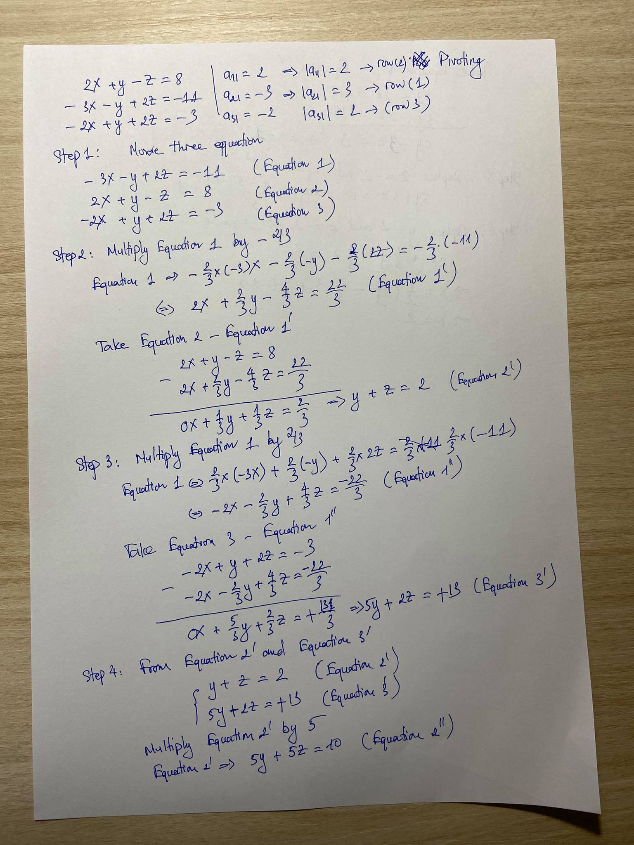
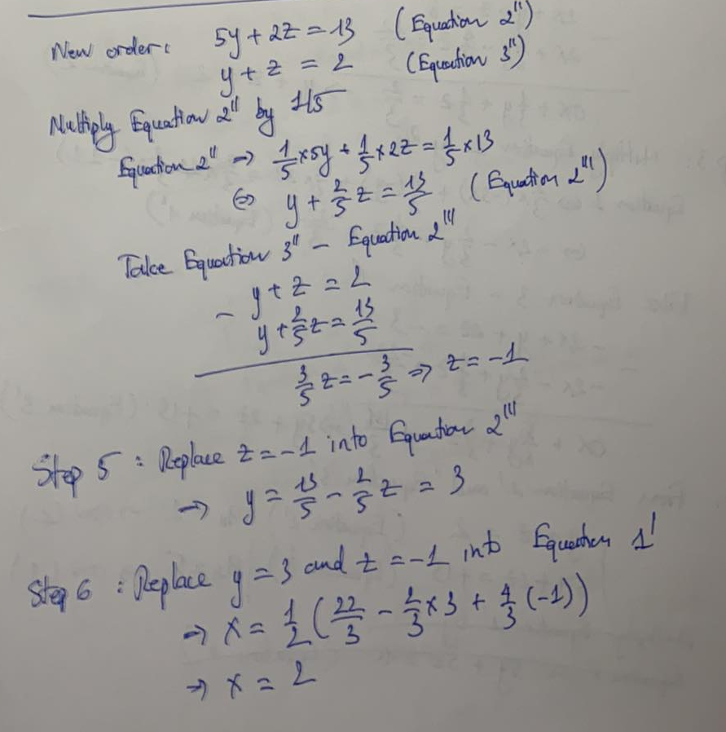
PIVOTING

Slide 12
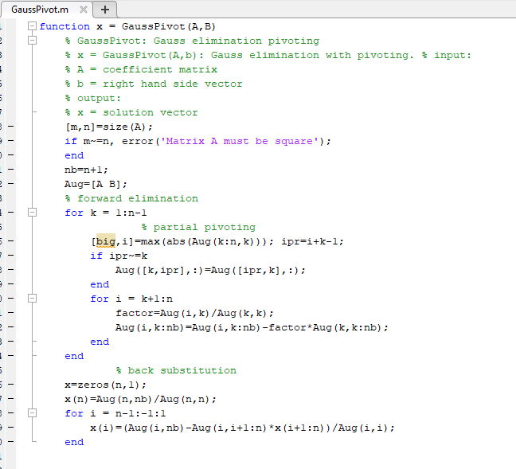
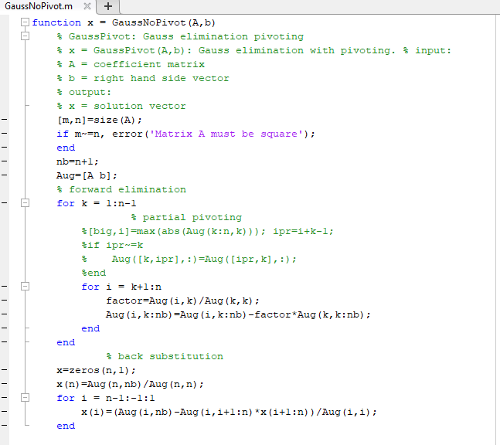
PIVOTING
NO PIVOTING

Slide 13
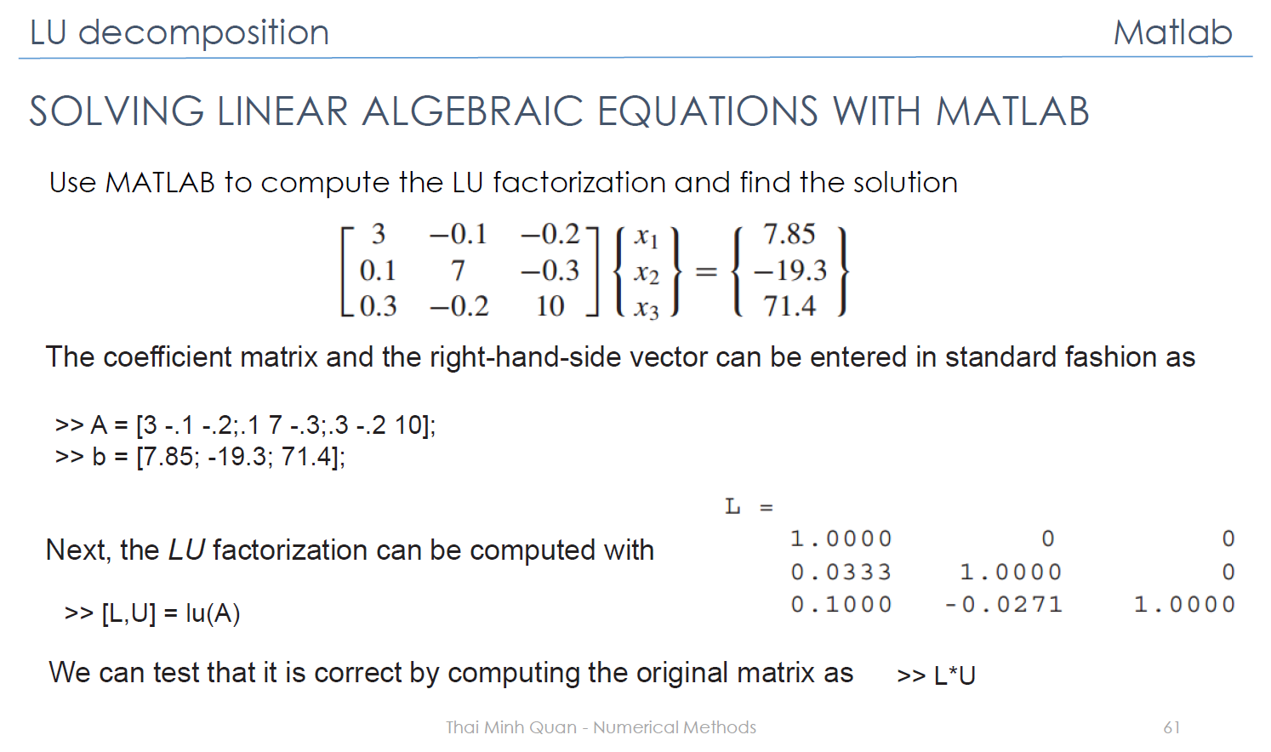
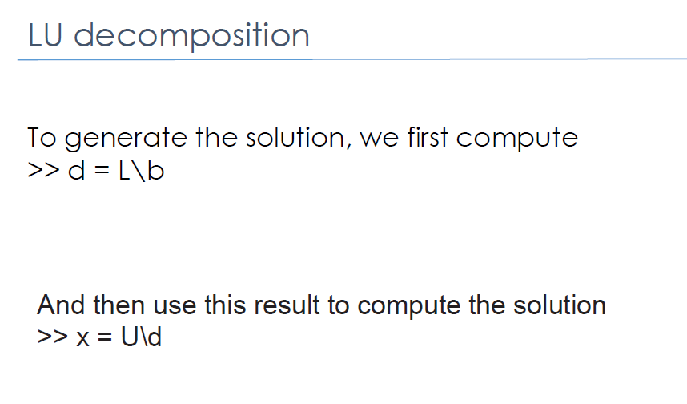
Labwork 3 – VI: LU Decomposition
Find the solution in page 61

Slide 14
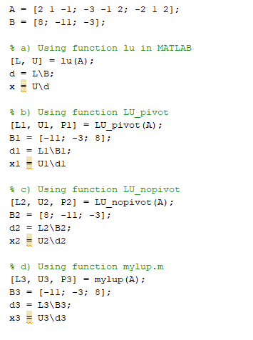

Labwork 3 – VI: LU Decomposition

Slide 15
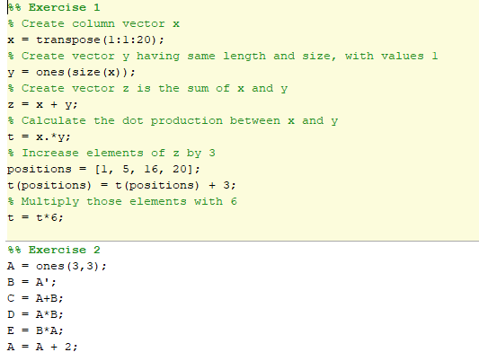
Labwork 3 – VII: Common Exercises

